Slide 1
CLASS- IX
SUBJECT – MATHMETICS
TOPIC – AREAS OF PARALLELOGRAMS AND TRIANGLES

Slide 2
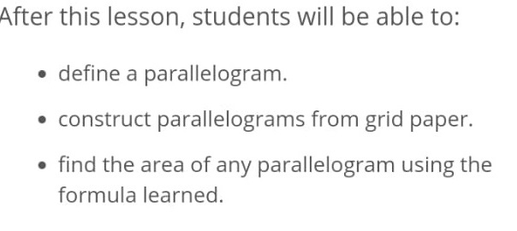
LEARNING OBJECTIVES

Slide 3
INTRODUCTION ON AREA OF PARALLELOGRAM

Slide 4
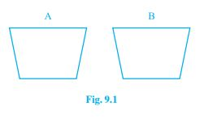
INTRODUCTION
You may recall that the part of the plane enclosed by a simple closed figure is called a planar region corresponding to that figure. The magnitude or measure of this planar region is called its area. This magnitude or measure is always expressed with the help of a number (in some unit) such as 5 cm2 , 8 m2 , 3 hectares etc. So, we can say that area of a figure is a number (in some unit) associated with the part of the plane enclosed by the figure.
We are also familiar with the concept of congruent figures from earlier classes and from Chapter 7. Two figures are called congruent, if they have the same shape and the same size. In other words, if two figures A and B are congruent (see Fig. 9.1) , then using a tracing paper you can superpose one figure over the other such that it will cover the other completely. So if two figures A and B are congruent, they must have equal areas. However, the converse of this statement is not true. In other words, two figures having equal areas need not be congruent. For example, in Fig. 9.2, rectangles ABCD and EFGH have equal areas (9 × 4 cm2 and 6 × 6 cm2 ) but clearly they are not congruent.

Slide 5
For example, in Fig. 9.2, rectangles ABCD and EFGH have equal areas (9 × 4 cm2 and 6 × 6 cm2 ) but clearly they are not congruent.

Slide 6
In Fig. 9.4(i), trapezium ABCD and parallelogram EFCD have a common side DC. We say that trapezium ABCD and parallelogram EFCD are on the same base DC. Similarly, in Fig. 9.4 (ii), parallelograms PQRS and MNRS are on the same base SR; in Fig. 9.4(iii), triangles ABC and DBC are on the same base BC and in Fig. 9.4(iv), parallelogram ABCD and triangle PDC are on the same base DC.

Slide 7
In Fig. 9.5(i), clearly trapezium ABCD and parallelogram EFCD are on the same base DC. In addition to the above, the vertices A and B (of trapezium ABCD) opposite to base DC and the vertices E and F (of parallelogram EFCD) opposite to base DC lie on a line AF parallel to DC. We say that trapezium ABCD and parallelogram EFCD are on the same base DC and between the same parallels AF and DC. Similarly, parallelograms PQRS and MNRS are on the same base SR and between the same parallels PN and SR [see Fig.9.5 (ii)] as vertices P and Q of PQRS and vertices M and N of MNRS lie on a line PN parallel to base SR.In the same way, triangles ABC and DBC lie on the same base BC and between the same parallels AD and BC [see Fig. 9.5 (iii)] and parallelogram ABCD and triangle PCD lie on the same base DC and between the same parallels AP and DC [see Fig. 9.5(iv)]. So, two figures are said to be on the same base and between the same parallels, if they have a common base (side) and the vertices (or the vertex) opposite to the common base of each figure lie on a line parallel to the base.

Slide 8
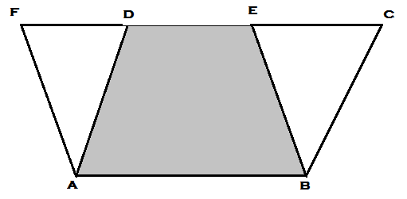
THEOREM-1
Parallelograms on the same base and between the same parallels are equal in area .
Given : Two II gms ABCD and ABEF on the same base AB and between same parallels AB and FC

Slide 9
To Prove : ar ( II gm ABCD ) = ar ( II gm ABEF )
Proof :
In Δ ADF and Δ BCE ,
AD = BC ( opposite sides of a parallelogram )
∠ ADF = ∠ BCE ( Corresponding angles , AD II BC )
∠ AFD = ∠ BEC ( Corresponding angles , AF II BE )
So , Δ ADF ≡ Δ BCE ( A - A - S congruency rule )
Then , ar (Δ ADF ) = ar (Δ BCE ) ………………….( 1 )

Slide 10
ar ( II gm ABCD ) = ar ( ABED ) + ar (Δ BCE )
= ar ( ABED ) + ar (Δ ADF )
= ar ( II gm ABEF )
So ar ( II gm ABCD ) = ar ( II gm ABEF )
Hence Proved .

Slide 11
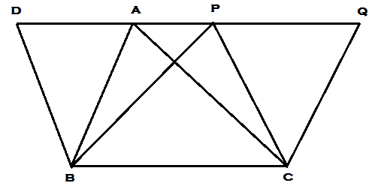
THEOREM-2
Triangles on the same base and between the same parallels are equal in area .
Given : Two triangles ABC and PBC , on the same base BC and between the same parallel lines BC and AP

Slide 12
To Prove : ar (Δ ABC ) = ar (Δ PBC )
Construction : Through B, draw BD II CP , intersecting line AP in D and through C ,
draw CQ II BA , intersecting line AP at Q
Proof :
Quadrilateral BCQA and BCPD are parallelograms .
II gms BCQA and BCPD are on the same base BC and between the same parallels BC and AP .
So ar ( II gm BCQA ) = ar ( II gm BCPD )
CA is the diagonal of II gm BCQA ,
ar (Δ ABC ) = ar (Δ PDB ) =1/2 ar ( II gm BCPD )

Slide 13
Similarly ar (Δ PBC ) = ar (Δ AQC )
=1/2 ar ( II gm BCQA )
So , ar (Δ ABC ) = ar (Δ PBC )
Hence Proved .

Slide 14
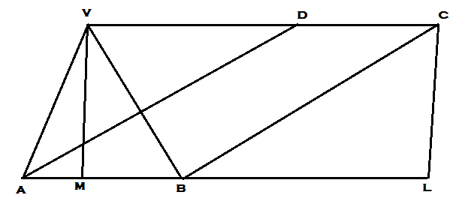
THEOREM-3
If a triangle and a parallelogram are on the same base and between the same parallels , the area of the triangle id equal to half that of parallelogram .

Slide 15
Given : Δ VAB and parallelogram ABCD are on the same base AB and between the same parallels AB and VC
To Proof : ar (Δ VAB ) = ½ ar ( II gm ABCD )
Construction : Draw CL perpendicular to AB meeting line AB in L and VM perpendicular to AB meeting Line AB in M .

Slide 16
Proof : V,D,C are co-llinear and DC II AB
VM = CL ( Distance between the parallel lines )
Now, ar (Δ VAB ) = ½ X VM X AB …………………..( 1 )
ar ( II gm ABCD ) = VM X AB …………………..( 2 )
From Eq^{n} (1) and ( 2 ) ,
ar (Δ VAB ) = ½ ar ( II gm ABCD )
Hence Proved .

Slide 17
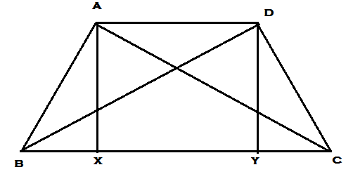
THEOREM-4
Two triangles having the same base or equal base and equal areas lie between the same parallels
Given : Δ ABC and Δ DBC having same base BC
ar (Δ ABC ) = ar (Δ DBC )

Slide 18
To Prove : Δ ABC and Δ DBC are in same parallel lines
Proof :
ar (Δ ABC ) = ar (Δ DBC ) (given)
⇒ ½ X BC X AX = ½ X BC X DY
⇒ AX = DY
But AX II DY
Then , AXYB is a II gm
and AD II XY
Then AD II BC
Δ ABC and Δ DBC are in same parallel lines
Hence Proved

Slide 19
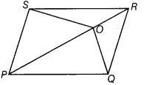
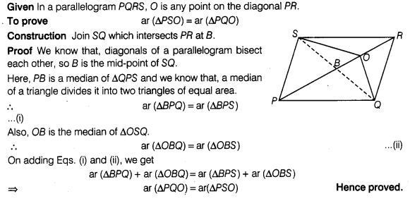
Question O is any point on the diagonal PR of a parallelogram PQRS (figure). Prove that ar(ΔPSO) = ar(ΔPQO).
:
Solution

Slide 20
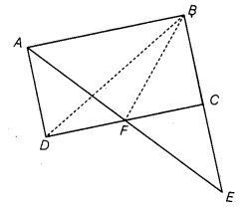
Question ABCD is a parallelogram in which BC is produced to E such that CE = BC.
AE intersects CD at F. If ar (ΔDFB) = 3 cm², then find the area of the
parallelogram ABCD.

Slide 21
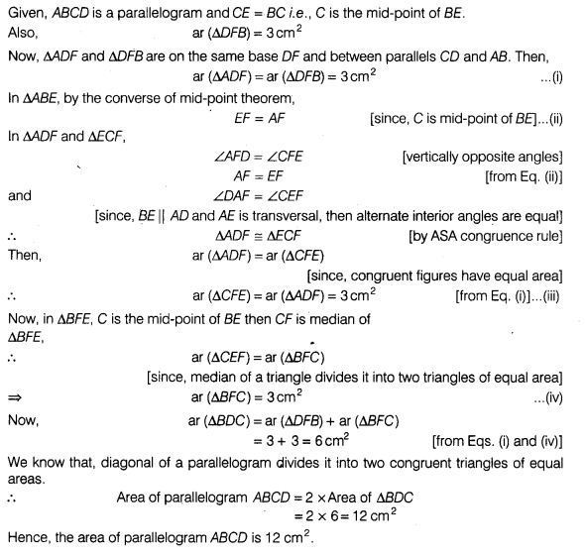
Solution:

Slide 22
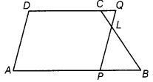
Question In trapezium ABCD, AB || DC and L is the mid-point of BC. Through L, a line PQ || AD has been drawn which meets AB in P and DC produced in Q. Prove that ar (ABCD) = ar (APQD). ∴ BL = CL

Slide 23
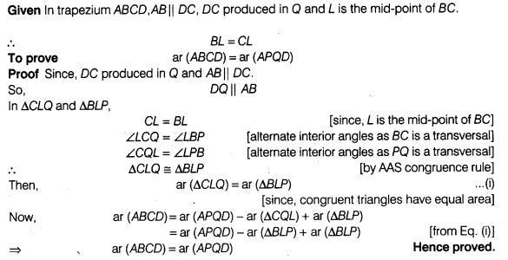
Solution:

Slide 24
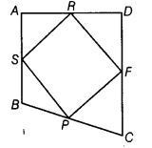
Question If the mid-points of the sides of a quadrilateral are joined in order, prove that the area of the parallelogram, so formed will be half of the area of the given quadrilateral (figure).

Slide 25
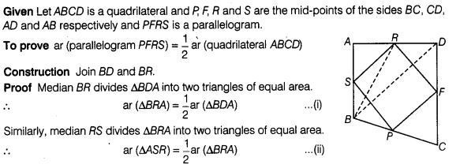
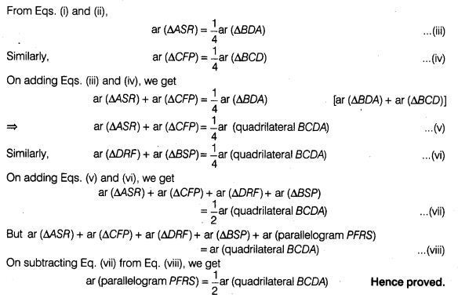
Solution:

Slide 26
OBJECTIVE
TO VERIFY PARALLELOGRAMS ON THE SAME BASE AND BETWEEN THE SAME PARALLELS ARE EQUAL IN AREA

Slide 27
MATERIAL S REQUIRED
GRAPH PAPER
SCISSORS
SCALE
PENCIL

Slide 28
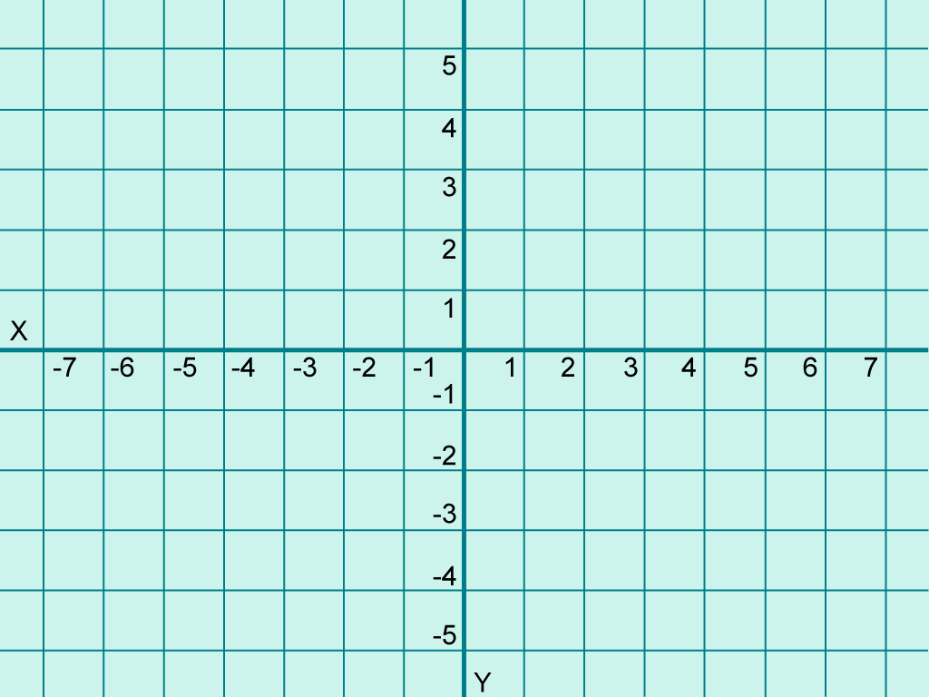
FIGURE
P
D
A
Q
B
C

Slide 29
PROCEDURE
Let us take a graph sheet and draw two parallelograms ABCD and PBCQ on it as shown in Fig
Now find the areas of these two parallelograms by counting the number of complete squares enclosed by the figure, the number of squares a having more than half their parts enclosed by the figure and the number of squares having half their parts enclosed by the figure. The squares whose less than half parts are enclosed by the figure are ignored.

Slide 30
OBSERVATION
The area of II gm ABCD = _____________________sq. units
The area of II gm PBCQ = _____________________sq. units
CONCLUSION
So, PARALLELOGRAMS ON THE SAME BASE AND BETWEEN THE SAME PARALLELS ARE EQUAL IN AREA

Slide 31
NOTES ON AREAS OF PARALLELOGRAM AND TRIANGLE
Plane region: The part of the plane enclosed by closed boundary is called plane region .
Area : The magnitude or the measure of the plane region is called its area .
Interior of Triangle : The part of the plane enclosed by a triangle is called the interior of the triangle .
Triangular region : The union of triangle and its interior is called triangular region .
Polygonal region : union of polygonal and its interior is called polygonal region .

Slide 32
Area Axioms
Every polygonal region R has an area , measured in square units and denoted by ar( R )
Conguent area axiom: R₁ and R₂ be two regions such that R₁ ≡ R₂ then ar( R₁ ) = ar( R₂ )
Area monotone Axiom : If R₁ and R₂ be two regions such that R₁ C R₂
then ar ( R₁ ) ≤ ar ( R₂ )
4. Area addition Axiom :If R₁ and R₂ are two polygonal regions ,whose intersection is a finite number of points and line segments and R = R₁ R ₂
then ar ( R ) = ar (R₁ ) + ar ( R₂ )
5. Rectangular area Axiom:
If AB = a unit andAD = b unit ,
then ar ( Rectanular Region ABCD ) =ab sq. unit

Slide 33
KEYPOINTS
1. Area of a figure is a number (in some unit) associated with the part of the plane enclosed by that figure.
2. Two congruent figures have equal areas but the converse need not be true.
3. If a planar region formed by a figure T is made up of two non-overlapping planar regions formed by figures P and Q, then ar (T) = ar (P) + ar (Q), where ar (X) denotes the area of figure.
4. Two figures are said to be on the same base and between the same parallels, if they have a common base (side) and the vertices, (or the vertex) opposite to the common base of each figure lie on a line parallel to the base.
5. Parallelograms on the same base (or equal bases) and between the same parallels are equal in area.

Slide 34
6. Area of a parallelogram is the product of its base and the corresponding altitude.
7. Parallelograms on the same base (or equal bases) and having equal areas lie between the same parallels.
8. If a parallelogram and a triangle are on the same base and between the same parallels, then area of the triangle is half the area of the parallelogram.
9. Triangles on the same base (or equal bases) and between the same parallels are equal in area.
10. Area of a triangle is half the product of its base and the corresponding altitude.
11. Triangles on the same base (or equal bases) and having equal areas lie between the same parallels.
12. A median of a triangle divides it into two triangles of equal areas.

Slide 35
CONCEPT MAPPING

Slide 36
THANK YOU

